Slide 1


A Calibration Method for Optical See-through Head-mounted Displays with a Depth Camera
Hanseul Jun Gunhee Kim
March 19, 2016

Slide 2
Outline
Problem Statement
Approach
Mathematical Model
Optimization Formula
Experiments
Conclusion

Slide 3

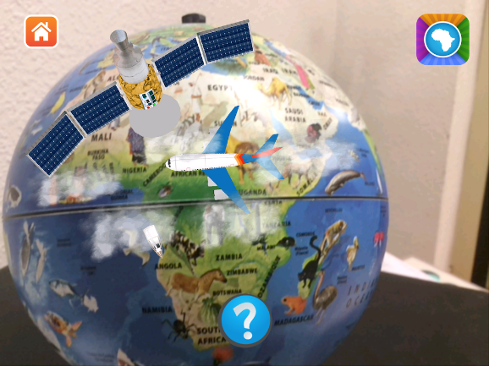
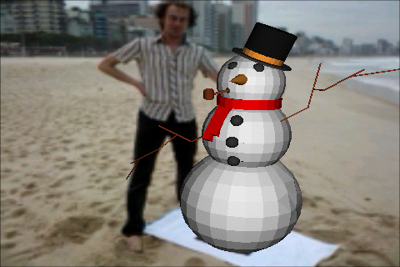
User wearing an OST-HMD
Suppose that a user is wearing a OST-HMD
User expects virtual objects to coexist with the real objects
Wrong positions of virtual objects lead to annoyance
Notes:
https://www.flickr.com/photos/smieyetracking/20344061815
https://www.flickr.com/photos/overig/4639331740
https://en.wikipedia.org/wiki/File:Augmented_reality_world_globe.png

Slide 4

User wearing an OST-HMD
Suppose that a user is wearing a OST-HMD
Since human visual systems are complex, we can not directly measure how the positions are wrong
Can we put the virtual objects in the right places?

Slide 5
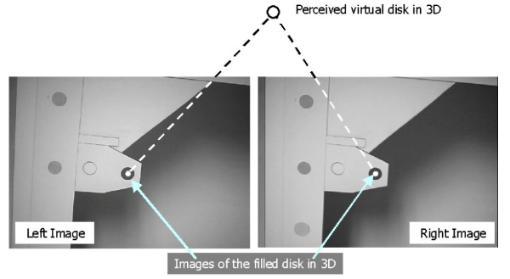
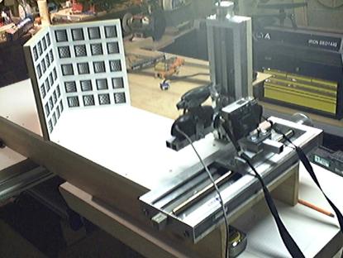
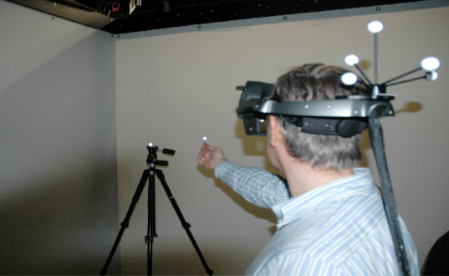
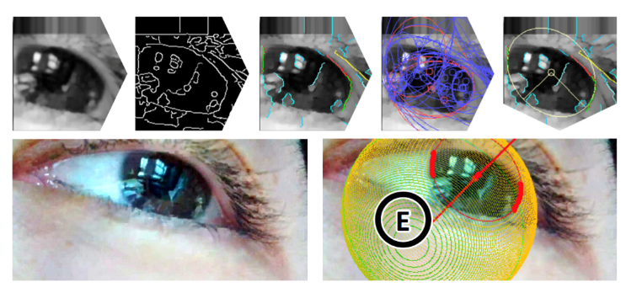
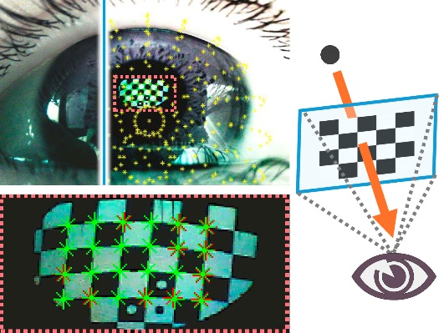
Previous Calibration Methods
[Genc et al., ISAR 2000]
[Owen et al., ISMAR 2014 ]
[Kellner et al., TVCG 2012 ]
Methods with User Interactions
Many more!
[Itoh et al., 3DUI 2014]
[Plopski et al., TVCG 2015 ]
Methods without User Interactions

Slide 6
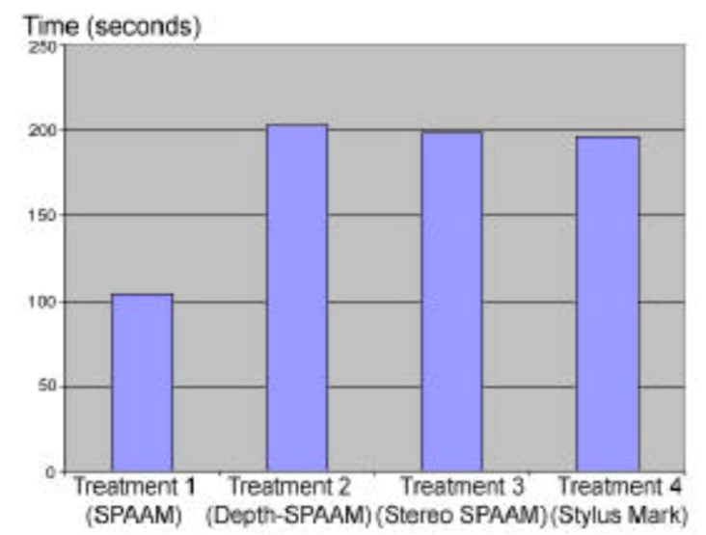
Limitations of Previous Works
Methods with User Interactions
Long user interaction time with additional devices
Methods without User Interactions
Perceptual eye centers are not identical to the anatomical eye centers with additional devices
Our goal: a perceptual and handy approach to calibration without any additional devices
Notes:
Arthur Tang et al., Evaluation of Calibration Procedures for Optical See-Through Head-Mounted Displays

Slide 7
Definition of Calibration
Naive Definition: put all virtual objects in the intended places
Mathematical Definition: figure out all user and device dependent parameters
Parameter 1: Depth-camera Extrinsic Parameter
Parameter 2: Display Extrinsic Parameter
Parameter 3: User Eye Positions

Slide 8
Our Goals
Objective: calibrate an OST-HMD for a user
Goal 1: calibrate an OST-HMD for a user with a perceptual model
Goal 2: calibrate an OST-HMD with a small amount of practical user interaction
Goal 3: calibrate an OST-HMD without additional devices

Slide 9
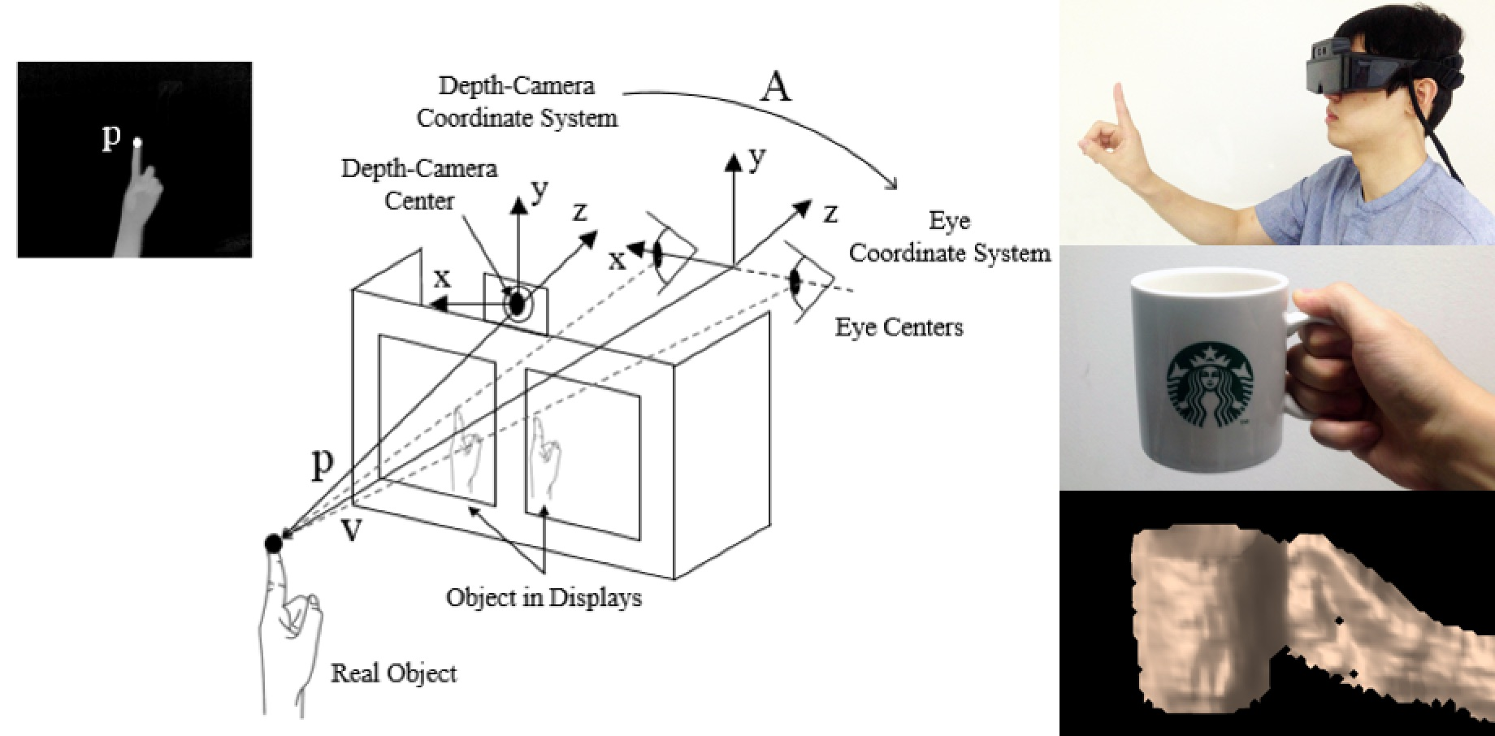
Our Solution
Calibration with a Depth-camera
(1) Perceptual Model without anatomical eye position estimation
(2) Fingertips for user interaction
(3) Depth-cameras for detection

Slide 10
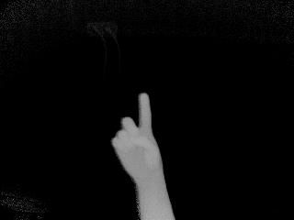
How to Calibrate?
How to know the intention of the users?
A set of positions of a user’s fingertip for a set of virtual targets
Infer user intentions through pointing correct positions
Users unconsciously know how to calibrate but do not know how to deliver the information
Pointing the correct positions does deliver the information

Slide 11
Outline
Problem Statement
Approach
Mathematical Model
Optimization Formula
Experiments
Conclusion

Slide 12
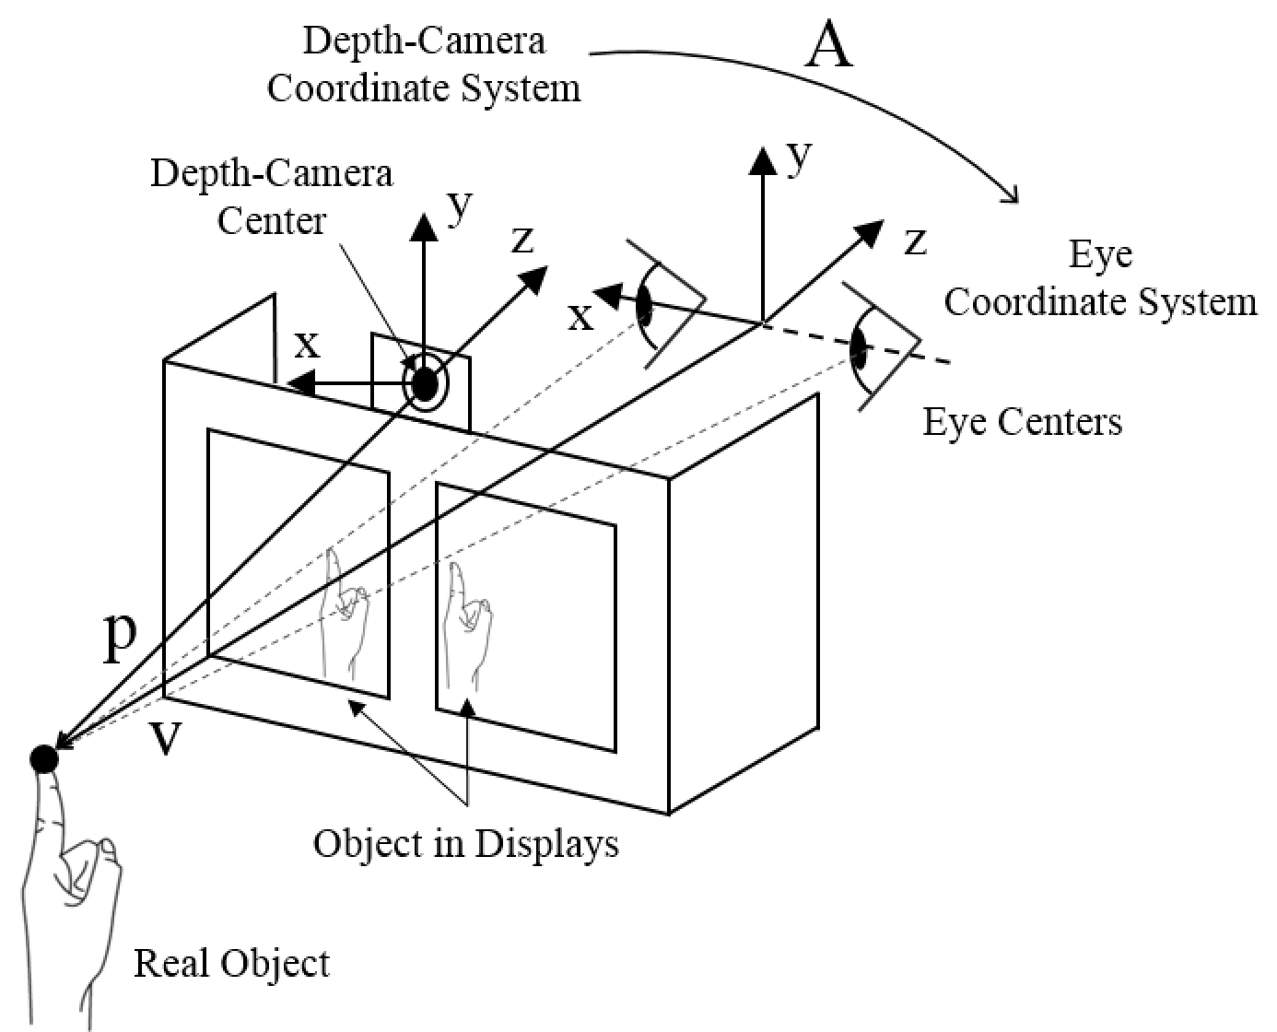
Overview of Model
Represents the system of a depth camera, a OST-HMD, and an user with a transformation A
2 coordinate systems
: depth-camera and eye
1 transformation
: a translation, a rotation, and an isotropic scaling

Slide 13
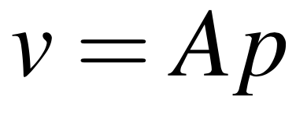
Overview of Model
Transformation A is inferred through the positions of virtual targets pointed by an user
p: pointed positions in the depth-camera coordinate system
v: intended positions of virtual targets

Slide 14
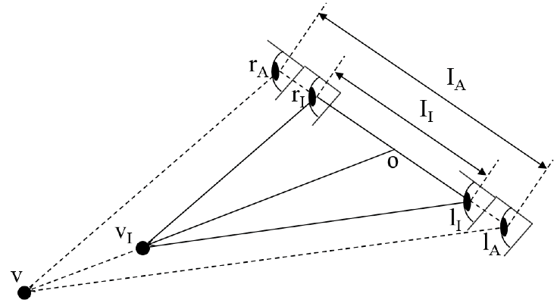
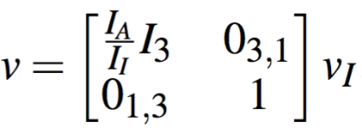
Components of Transformation A
A
Camera
Displays
User Eyes
T + R
T + R + S
(T) Camera position
(R) Camera rotation
(T) Eye position
(R) Eye rotation
(S) Interpupillary distance (IPD)
Notes:
v=[]v_i 굵게 해보기 (다음장과 통일)

Slide 15
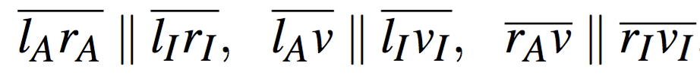
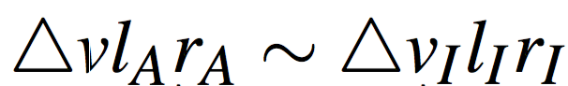
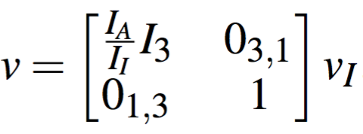
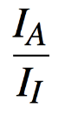

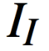
Components of Transformation A
Discrepancy between the actual IPD and the initialized IPD results in an isotropic scaling
: actual IPD
: initialized IPD
(Isotropic scaling of )

Slide 16
Outline
Problem Statement
Approach
Mathematical Model
Optimization Formula
Experiments
Conclusion

Slide 17
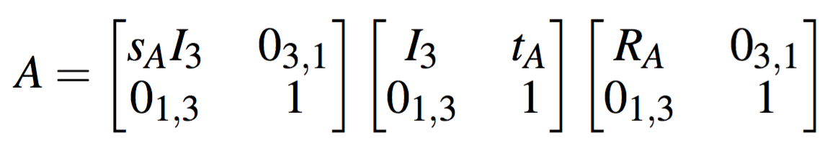
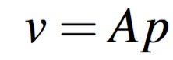
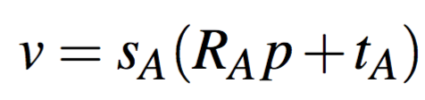
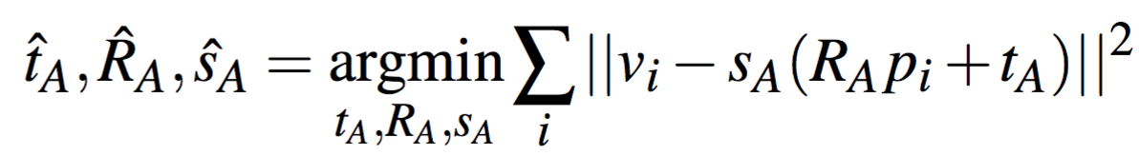
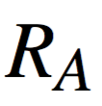
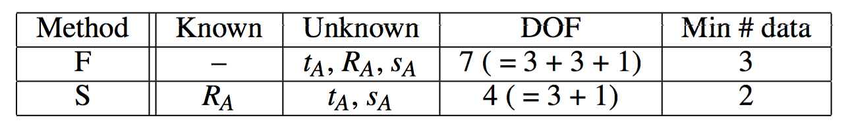
Optimization Objective
Uses component-wise interpretation of Transformation A
, where
componentize
obtain the objective
Without a known : Full Calibration
With a known : Simplified Calibration
Notes:
Obtain the objective 화살표가 || ||를 가리키도록
2페이지로 나눠볼 것
아래쪽 표 뒤에도 나오니까 지워보는 것 고려

Slide 18
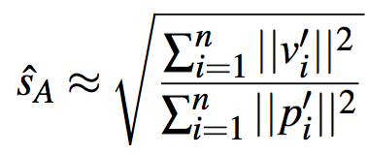
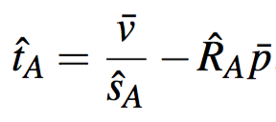
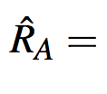
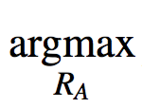
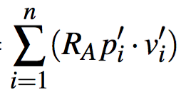
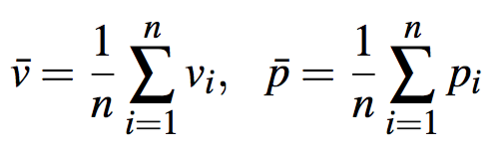
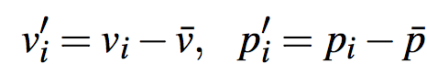
Optimization Objective
obtain the objective
where
,
Optimize Transformation A with pairs of p and v
(the above formula historically comes from [Horn, JOSA A 1987])

Slide 19

Degree of Freedom (DOF)
Without a known : Full Calibration
With a known : Simplified Calibration
Less DOF
DOF
Optimization quality
Better Optimization
Reuse stable Rotation for better calibration

Slide 20
Outline
Problem Statement
Approach
Mathematical Model
Optimization Formula
Experiments
Conclusion

Slide 21
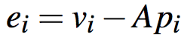
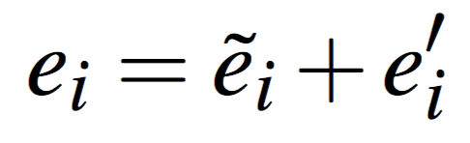
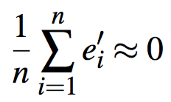
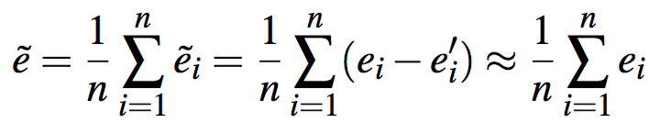
Experiment Criteria
Criterion 1: smaller calibration errors = better calibration
Criterion 2: smaller number of interactions = better calibration
How to get calibration errors?
Gather 3D position error:
Divide it (calibration error + non-calibration error):
Apply law of large numbers (assume Gaussian):
Extract calibration error:

Slide 22
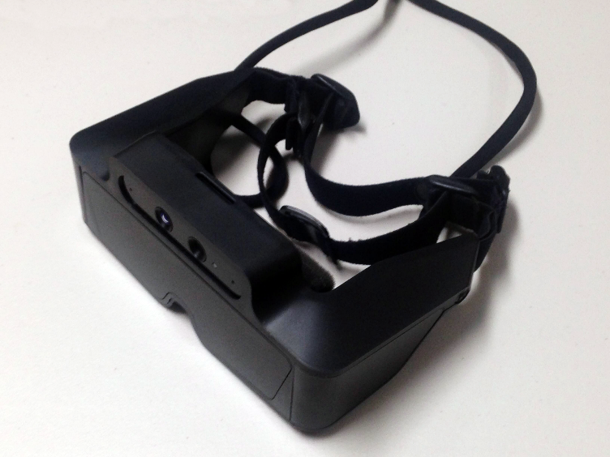
Experiment Setup
Subjects: 20 people not familiar to OST-HMDs
Baseline: stereo-SPAAM [Genc et al., ISAR 2000]
Modified to work better for depth-cameras
Hardware: Meta 1
Affordable Price: $667
960x540 resolution displays
320x240 resolution depth-camera
depth-camera

Slide 23
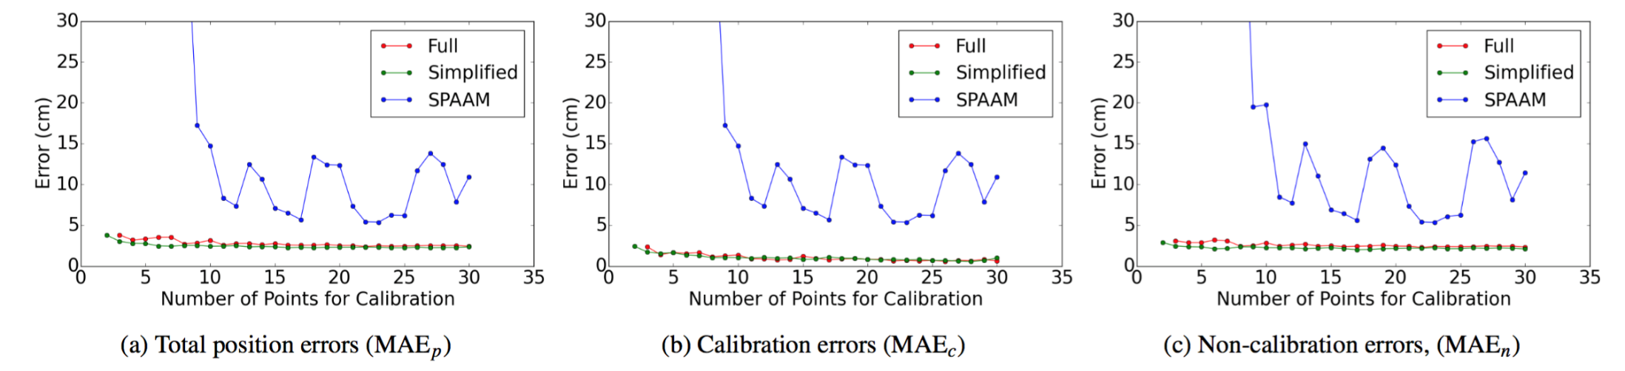
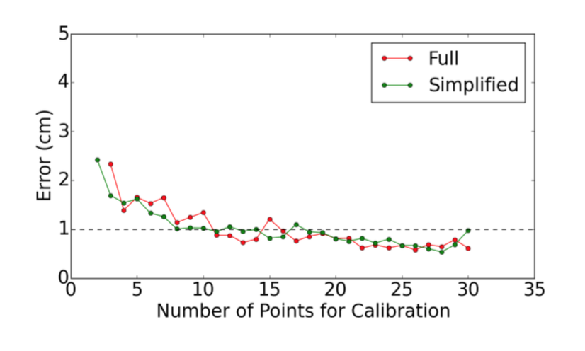
Quantitative Results
Measured 3D calibration position errors
Used mean absolute errors (MAE) of the subjects
Used mean absolute errors to tell the proper number of interactions
To achieve <1 cm, >11 (full) and >8 (simplified) recommended.

Slide 24
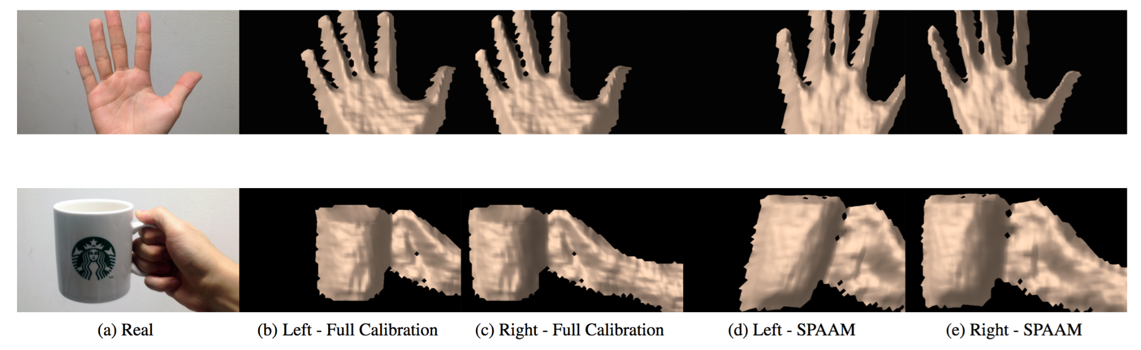
Qualitative Results
Our method well aligns the left and right displays
Our calibration model handles both displays at the same time
Better alignment improves user experiences

Slide 25
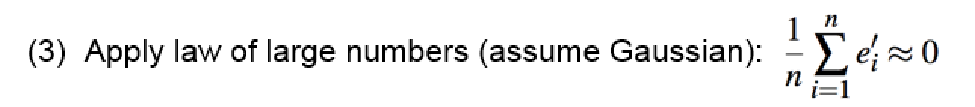
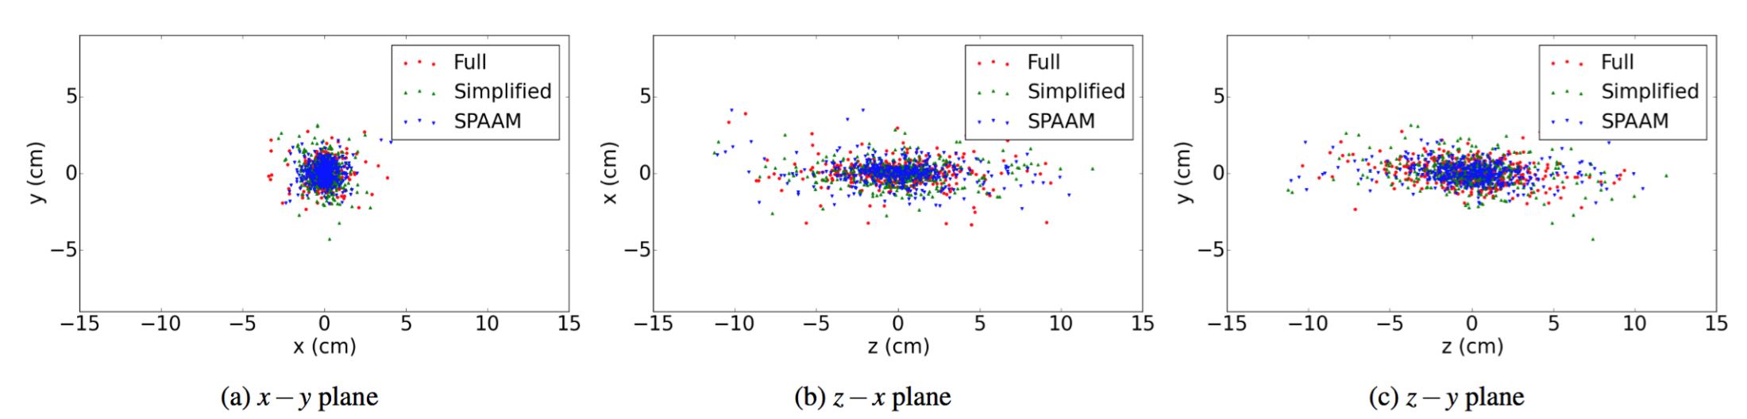
Non-calibration Error Distribution
Supports our assumption of Gaussian distribution
Validates our calibration error extraction step 3
The variation is larger along the z-axis since it comes from disparity, that makes it more vulnerable to errors

Slide 26
Outline
Problem Statement
Approach
Mathematical Model
Optimization Formula
Experiments
Conclusion

Slide 27
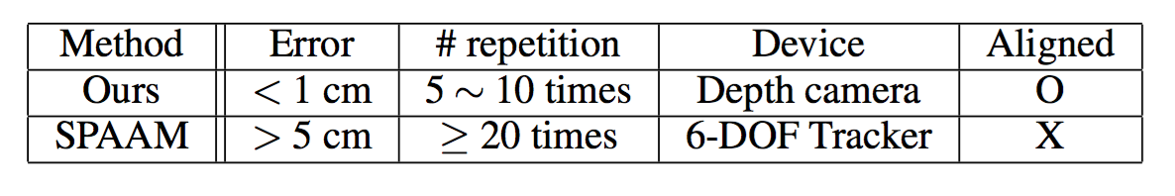

Conclusion
Our calibration method
utilizes depth camera commonly included in HMDs.
works with a small number of interactions.
results with aligned displays.
works for novice users with affordable HMDs.

Slide 28
Thank you!

